Slide 1
Licensor Name and Licensing Agent Name in Funds Expenditure
Yoel Kortick. Senior Librarian

Slide 2
Introduction

Slide 3
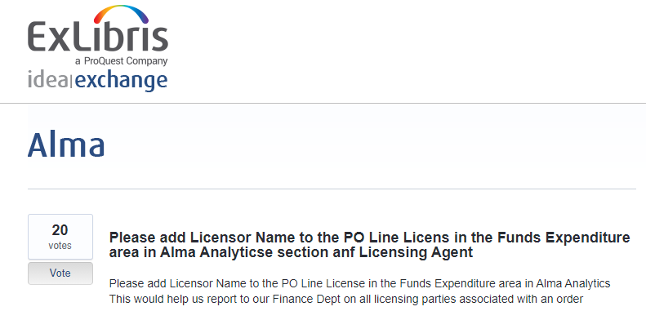
Introduction

Slide 4
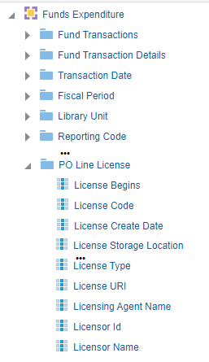
Introduction
Licensor Name and Licensing Agent Name fields have been added to Funds Expenditure SA under PO Line License folder:

Slide 5
Example

Slide 6
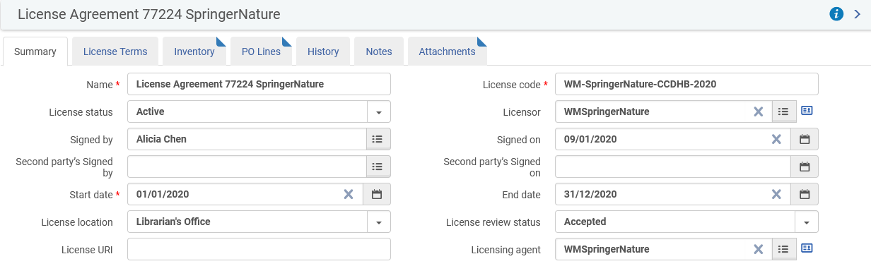

Example
This is the license in Alma
This is the license in Analytics

Slide 7
Example
Note that Alma is displaying the Licensor/Licensing Agent code while Analytics display the Licensor/Licensing Agent name:

Slide 8
Yoel.Kortick@exlibrisgroup.com

